Slide 1

Machine Learning
Summer Internship- 2026
Name: Udita
Supervisor: Prof. Millie Pant
Mentor: Ms. Riya Applied Mathematics & Scientific Computing
Indian Institute of Technology Roorkee

Slide 2

Table of content
Introduction to Machine Learning
Data Pre-processing & EDA
Linear & Logistic Regression
Decision Trees & Random Forests
SVM & K-Nearest Neighbours
Clustering & Dimensionality Reduction
Model Evaluation & Hyperparameter Tuning
Feature Engineering & Pipelines
Introduction to NLP
Machine Learning Capstone

Slide 3
Introduction to Machine Learning
Machine learning:
Machine Learning (ML) is a branch of Artificial Intelligence that enables computers to learn patterns from data and make predictions or decisions without being explicitly programmed for every task.
Machine learning workflow :
Types of Machine Learning:
1. Data Collection
1. Supervised Learning:
In supervised learning, the model is trained using labeled data, where both the input and the correct output are provided.
2.Data Pre-processing
• Clean data • Handle missing • Feature selection
Examples:
Email spam detection
House price prediction
Common algorithms:
Linear Regression
Decision Tree
Random Forest
3. Train-Test Split (80% Train, 20% Test)
2. Unsupervised Learning:
In unsupervised learning, the model is trained on unlabeled data. It tries to discover hidden patterns or groupings in the data.
Examples:
Customer segmentation
4. Model Training Learn from data
Common algorithms:
K-Means Clustering
3. Reinforcement Learning:
In reinforcement learning, an agent learns by interacting with an environment. It receives rewards for good actions and penalties for bad ones, gradually learning the best strategy.
5. Model Evaluation Accuracy, Precision, Recall, F1 Score
Examples:
Robot navigation
Self-driving cars
6. Prediction & Deployment

Slide 4
Key Machine Learning Terminology:
1. Features
Features are the input variables or attributes used by a machine learning model to make predictions.
They describe the characteristics of the data.
Also known as independent variables or predictors.
Example:
For predicting house prices, features might include:
Size of the house (sq. ft.)
Number of bedrooms
Location
Age of the house
3. Training
Training is the process of teaching the machine learning model using a training dataset.
During training, the model learns the relationship between features and labels by identifying patterns in the data.
The goal is to build a model that can make accurate predictions on new data.
Example:
A model is trained using 8,000 labeled emails to learn how to distinguish spam from legitimate emails.
2. Labels
Labels are the correct output values that the model is trying to predict.
Also called the target variable or dependent variable.
Labels are available only in supervised learning.
Example:
House price (₹50,00,000)
Email category (Spam or Not Spam)
Student result (Pass or Fail)
4. Testing
Testing is the process of evaluating the trained model using a testing dataset that it has not seen before.
It measures how well the model performs on new, unseen data.
Common evaluation metrics include accuracy, precision, recall, and F1-score (for classification), or mean squared error (MSE) (for regression).
Example:
After training on 8,000 emails, the model is tested on 2,000 new emails to assess its prediction accuracy.

Slide 5
Data Preprocessing & EDA
Data Preprocessing in Machine Learning:
Data preprocessing is the process of cleaning and transforming raw data into a suitable format for machine learning models.
Why is it important?
Improves model accuracy
Handles missing or inconsistent data
Converts data into numerical form
Makes data suitable for algorithms
Handling Missing Values:
Missing values occur when data is not recorded for some observations.
Problems caused:
Reduces accuracy
Bias in model
Incomplete analysis
Methods to Handle Missing Values:
1. fillna() → Replace missing values
Used when we want to keep all rows.
2. dropna() → Remove missing values
Used when missing data is large or not important.
Example:
import pandas as pd df[‘Age’] = df['Age'].fillna(df['Age'].mean()) df['City'] = df['City'].fillna("Unknown“)
Example:
df = df.dropna()
Common strategies:
Mean (for numerical data)
Median (for skewed data)
Mode (for categorical data)
Constant value (0, "Unknown")

Slide 6
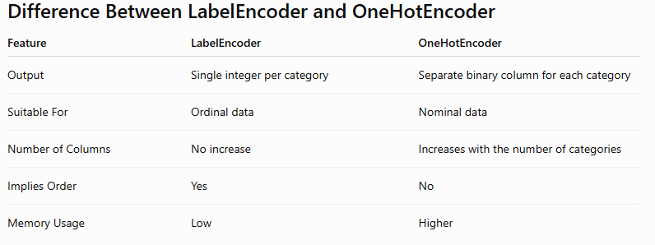
Encoding Categorical Variables:
Encoding categorical variables means converting text-based data (categories) into numerical form, so that machine learning models can understand and process it.
Why Encoding is Important
ML models cannot process text directly
Converts categories into machine-readable format
Improves model performance and compatibility
Required step in data preprocessing
Types of Encoding:
1. Label Encoding:
2. One-Hot Encoding:
One-Hot Encoding creates a separate column for each category and uses:
1 → category is present
0 → category is not present
Label Encoding converts each category into a unique integer value.

Slide 7
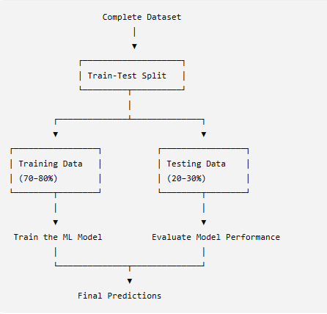


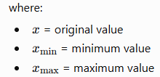
Feature Scaling:
Train-Test Split:
Feature scaling is the process of transforming numerical features into a common scale so that all variables contribute equally to machine learning models.
Train-test split is the process of dividing a dataset into two separate parts:
Training Set – Used to train the machine learning model.
Testing Set – Used to evaluate the model's performance on unseen data.
1. StandardScaler:
StandardScaler transforms data so that:
Mean = 0
Standard deviation = 1
This is also called Z-score normalization.
Formula:
Where:
X = original value
μ = mean
σ = standard deviation
2. MinMaxScaler:
MinMaxScaler rescales features to a fixed range, usually 0 to 1.
Formula

Slide 8
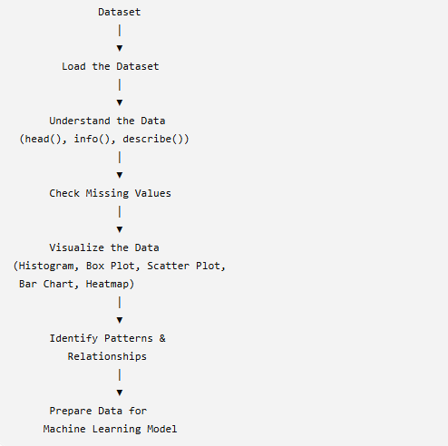
Exploratory Data Analysis (EDA):
Exploratory Data Analysis (EDA) is the process of analyzing and visualizing a dataset to understand its structure, patterns, relationships, and anomalies before building a machine learning model.
Libraries Used for EDA
Common EDA Workflow :
1. Matplotlib
Creates line charts, bar charts, histograms, scatter plots, etc.
Highly customizable
Basic plotting library in Python
2. Seaborn
Creates attractive and informative statistical visualizations
Requires less code than Matplotlib
Built on top of Matplotlib
Common Visualization Techniques
Histogram : Shows the distribution of numerical data.
Box Plot : Detects outliers and shows data spread.
Scatter Plot :Shows the relationship between two numerical variables.
Bar Chart : Compares different categories.

Slide 9


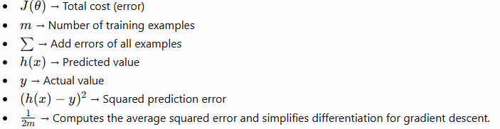
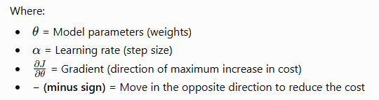
Linear & Logistic Regression
Linear Regression:
Linear Regression is a supervised machine learning algorithm used to predict a continuous numerical value based on one or more input features.
Examples
Predicting house prices
Predicting employee salary
Gradient Descent:
Cost Function (Error Function):
It measures how wrong the model is.
Gradient Descent is an algorithm used to reduce the cost (error) by updating the model's parameters (weights).
Formula:
Formula:
where

Slide 10

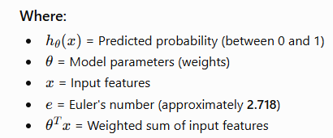
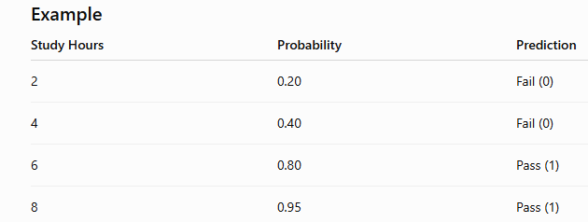
Logistic Regression for Binary Classification:
Logistic Regression is a machine learning algorithm used to classify data into two groups.
This is called binary classification because there are only two possible outputs.
0 = No
1 = Yes
Sigmoid Function:
The Sigmoid Function is a mathematical function used in Logistic Regression.
Its job is to convert any number into a probability between 0 and 1.
Formula:
Examples
Email → Spam (1) or Not Spam (0)
Student → Pass (1) or Fail (0)

Slide 11



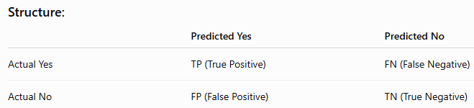
Metrics:
MSE (Mean Squared Error):
MSE tells how far predictions are from actual values.
Formula:
Lower MSE = better model
RMSE (Root Mean Squared Error):
RMSE is just square root of MSE
Formula:
Shows error in original units
R² Score:
Shows how well model explains data.
Range:
1 → Perfect model
0 → Bad model
Negative → Worse model
Accuracy:
Accuracy tells how many predictions are correct
Formula:
Used in classification.
Confusion Matrix:
A table that shows correct and wrong predictions in detail

Slide 12
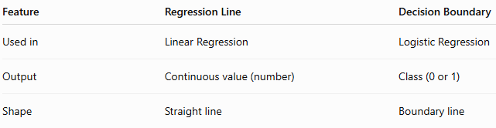
Plotting regression line and decision boundary:
Regression Line:
A regression line is a straight line that shows the relationship between input and output (continuous values).
Decision Boundary:
A decision boundary is a line that separates two classes (0 and 1).
Comparison:
Decision Tree:
A Decision Tree is a machine learning algorithm that makes decisions by asking questions step by step, just like a flowchart.
A Decision Tree splits data step-by-step to make decisions.
To decide the best split, it uses 3 important concepts:
Gini Impurity 2. Entropy 3. Information Gain

Slide 13
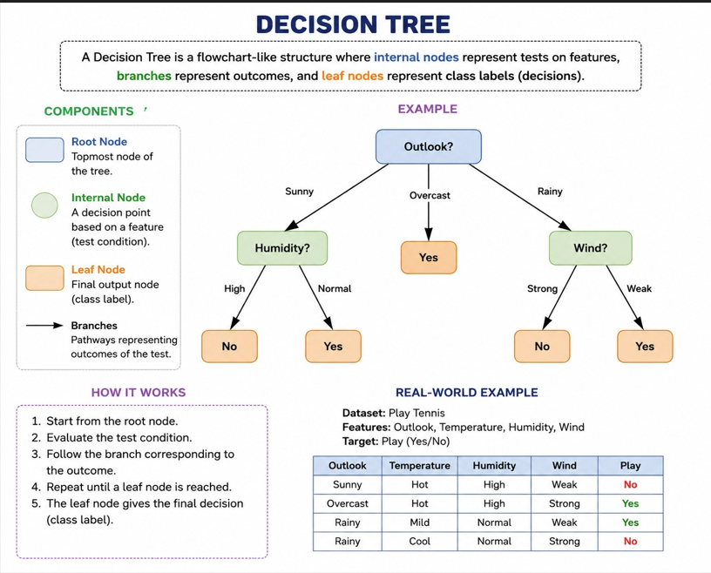

Slide 14


Decision Tree:
Gini Impurity:
Gini impurity tells how mixed the data is in a node.
0 → Pure node (only one class) ✅
High value → Mixed classes ❌
Formula:
Entropy:
Entropy measures uncertainty or randomness in data.
0 → No uncertainty (pure)
1 → Maximum uncertainty (mixed)
Formula:
Information Gain:
Information Gain tells how much a feature improves the split.
Higher Information Gain = better feature
Formula: IG=Entropy(before)−Entropy(aftersplit)
Random Forest:
A Random Forest is a machine learning algorithm that combines many decision trees to make a final prediction.
Bagging:
It means “Train multiple models on different random samples of data and combine their results.”
SVM & K-Nearest Neighbors
SVM (Support Vector Machine)
SVM:
SVM is a classification algorithm that finds the best boundary (hyperplane) to separate classes.
Concept | Meaning | Key Idea
Hyperplane | Decision boundary separating classes | Line/plane that divides data
Margin | Gap between classes | SVM maximizes margin
Support Vectors | Closest points to hyperplane | They decide boundary
Kernel Trick | Converts data to higher dimension | Helps non-linear separation

Slide 15
KNN (K-Nearest Neighbors)
KNN is a simple algorithm that classifies data based on nearest neighbors.
Cross-Validation (k-fold CV):
Cross-validation is used to check model performance properly.
Clustering & Dimensionality Reduction
K-Means Clustering:
K-Means Clustering is an unsupervised learning algorithm that groups similar data points into K clusters.
DBSCAN:
DBSCAN (Density-Based Spatial Clustering of Applications with Noise) is an unsupervised clustering algorithm that groups data based on density (how closely points are packed together)
Concept | Meaning | Key Idea
Clustering | Grouping similar data points | Unsupervised learning
Centroids | Center point of a cluster | Mean of all points in cluster
Inertia | Sum of squared distances | Measures cluster compactness
Elbow Method | Technique to choose K | Find “elbow point” in graph

Slide 16
Model Evaluation & Hyperparameter Tuning:
Model Evaluation
Model evaluation is the process of measuring how well a trained model performs on unseen data.
Hyperparameter Tuning
Hyperparameter tuning is the process of finding the best settings (hyperparameters) for a model to improve performance.
Comparison Table
Aspect | Model Evaluation | Hyperparameter Tuning
Purpose | Measure performance | Improve performance
Action | No changes made | Model settings are changed
Output | Final score (accuracy, F1, etc.) | Best hyperparameters
Data used | Test/validation data | Validation/CV data
Stage | After training | During model building

Slide 17
Bias vs Variance Tradeoff
Aspect | Bias | Variance
Cause | Too simple model | Too complex model
Problem | Underfitting | Overfitting
Training error | High | Low
Test error | High | High (unstable)
Sensitivity to data | Low | High
Bias-Variance Tradeoff
In real models:
Reducing bias often increases variance
Reducing variance often increases bias
Goal:
Find a balanced model with:
Low bias
Low variance

Slide 18
Feature Engineering & Pipelines
Aspect | Feature Engineering | Pipeline
What it is | Process of creating/improving features | End-to-end workflow
Focus | Data transformation | Automation & structure
Scope | One step or multiple steps | Entire ML process
Output | Better features | Reproducible ML system
1. Feature Selection
Feature selection means choosing the most useful features and removing irrelevant ones to improve model performance and reduce overfitting.
2. Creating New Features
Feature creation helps models learn hidden patterns better than raw data.
3. Sklearn Pipeline
A Pipeline chains all ML steps into a single workflow.
4. ColumnTransformer (Mixed Data Types)
Applies different transformations to different columns.

Slide 19
Introduction to NLP
1. Text Preprocessing
Before using text in ML models, we clean and standardize it.
a) Tokenization
Meaning:
Splitting text into smaller units (tokens) like words or sentences.
b) Stopwords Removal
Meaning:
Removing common words that don’t add much meaning.
c) Stemming
Meaning:
Reducing words to their root form (rough cut).
Bag of Words (BoW) & TF-IDF
These convert text into numerical vectors.
Sentiment Analysis Basics
Meaning:
Determining emotion or opinion in text:
Positive 😊
Negative 😡
Neutral 😐
TF-IDF (Term Frequency - Inverse Document Frequency)
Meaning:
Gives higher weight to important words, lower to common words.

Slide 20
Machine Learning Capstone
1. Problem Definition
Meaning:
Clearly define what you are trying to solve.
End-to-End Workflow
2. Dataset Selection
Sources:
Kaggle datasets
UCI Machine Learning Repository
APIs
Company/internal data
1. Problem Definition
↓
2. Dataset Collection
↓
3. EDA (Understand data)
↓
4. Preprocessing (clean + encode + scale)
↓
5. Model Training
↓
6. Evaluation (metrics)
↓
7. Visualization + Insights
3. Full ML Pipeline
Step A: EDA (Exploratory Data Analysis)
Meaning:
Understanding the dataset before modeling.
Step B: Data Preprocessing
Meaning:
Clean and prepare data for ML models.
Step C: Modelling
Meaning:
Train machine learning models on processed data.
Step D: Evaluation
Meaning:
Measure how well the model performs.

Slide 21
References
Website | Link | Why it is Useful
GeeksforGeeks | https://www.geeksforgeeks.org/machine-learning/ | Simple explanations, beginner-friendly content
Wikipedia | https://en.wikipedia.org/wiki/Machine_learning | Reliable definitions and background knowledge
Analytics Vidhya | https://www.analyticsvidhya.com | Easy-to-understand ML explanations
Towards Data Science | https://towardsdatascience.com | Real-world ML examples and insights
Kaggle | https://www.kaggle.com | Best for practical examples and visuals
Scikit-learn documentation | https://scikit-learn.org | Accurate technical reference for ML models

